Slide 1
Clamp Test

Slide 2
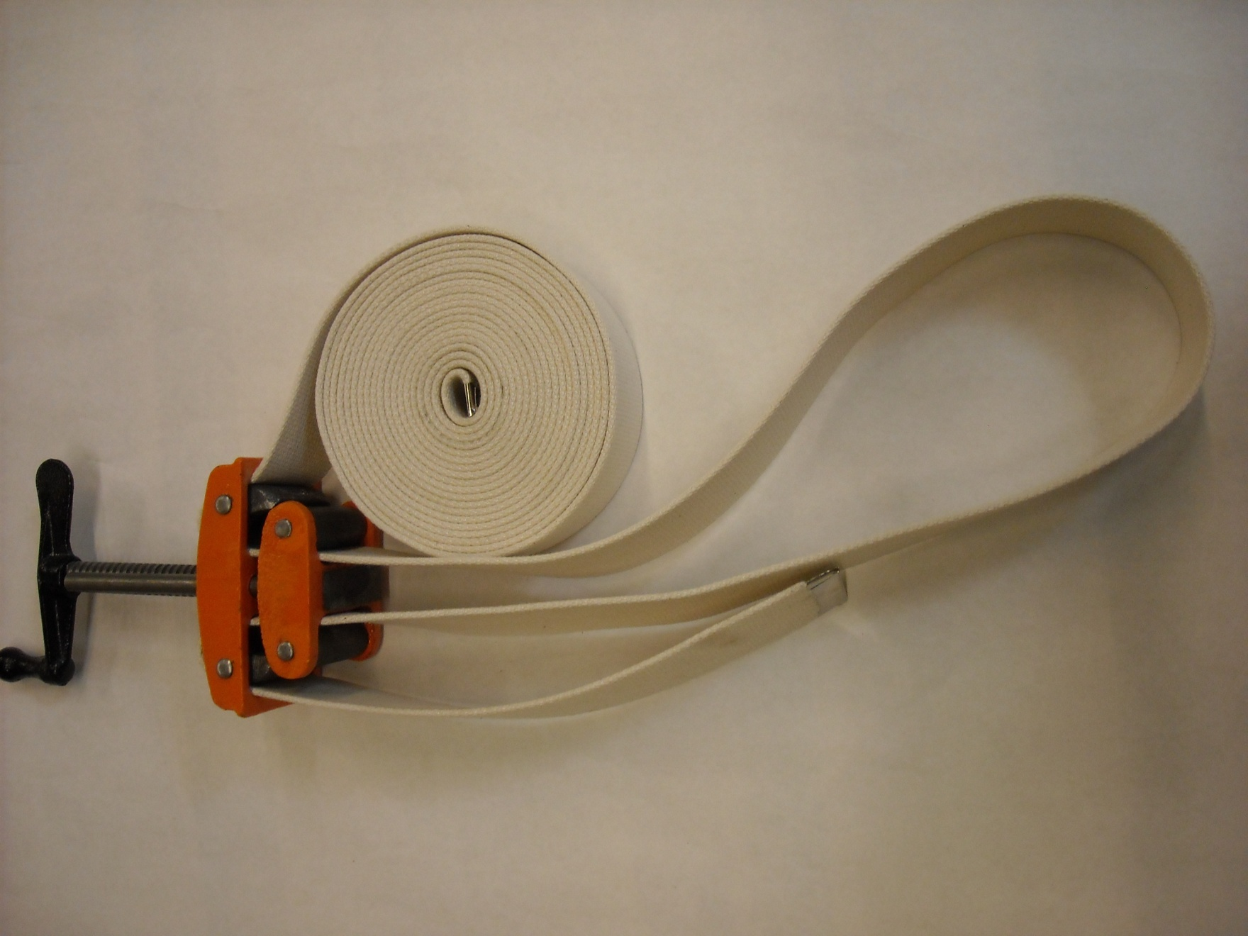
1. Strap Clamp_

Slide 3
2. _Cabinet clamp

Slide 4
3. __Spring clamp__

Slide 5
4.Vice grip clamp

Slide 6
5. Bar Clamp

Slide 7
6. C-Clamp

Slide 8
7. Parallel Clamp

Slide 9
8. Quick grip clamp

