Slide 1
Machine Test
Mr. Wilsons woods class

Slide 2
1. Grinder

Slide 3
2. Band Saw

Slide 4
3. Wood Lathe

Slide 5
4. Horizontal Boring Machine

Slide 6
5. Scroll Saw

Slide 7
6. Disc/Belt Sander

Slide 8
7. Dove Tail Machine

Slide 9
8. Drill Press

Slide 10
9. Panel Saw

Slide 11
10. Molding Machine

Slide 12
11. European Hinge Machine or Concealed Hinge Machine

Slide 13
12. Shaper

Slide 14
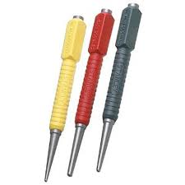
13. Nail Set

Slide 15
14. Pocket Hole Machine

Slide 16
15. Wide Belt Sander

Slide 17
16. Surface Planer

Slide 18
17. Miter Saw

Slide 19
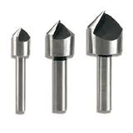
18. Counter Sink

Slide 20
19. Panel Router

Slide 21
20. Up-Cut Saw

Slide 22
21. Wood Chisel

Slide 23
22. Back Saw

Slide 24
23. Hack Saw

Slide 25
24. Dove Tail Saw

Slide 26
25. Hand Saw

Slide 27
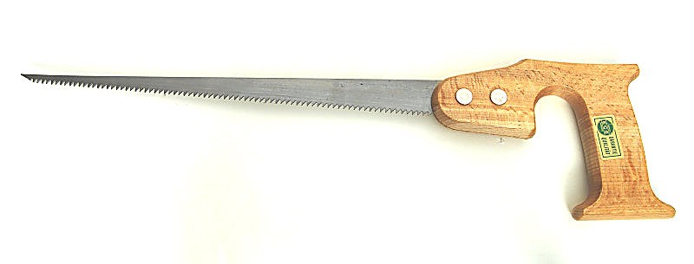
26. Key Hole Saw

Slide 28
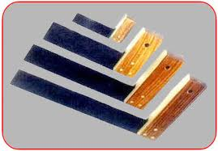
27. Tri Square

Slide 29
28. Claw Hammer

Slide 30
29. Rubber Mallet

Slide 31
30. Coping Saw

Slide 32
31. File Card

Slide 33
32. Compass

Slide 34
33. Combination Square

Slide 35
34. Brad Nailer or Pneumatic Nailer

Slide 36
35. Sliding T-Bevel

Slide 37
36. Electric Drill

Slide 38
37. Hand Plane

Slide 39
38. Hand Router

Slide 40
39. Jig Saw

Slide 41
40. Biscuit Jointer

Slide 42
41. Random Orbital Sander

Slide 43
42. Cordless Drill

Slide 44
43. Impact Driver

Slide 45
44. Belt Sander

Slide 46
45. Palm Sander

Slide 47
46. Vibrating Sander

Slide 48
47. Jointer

Slide 49
48. Oscillating Spindle Sander

Slide 50
49. Table Saw

Slide 51
50. Table Router

Slide 52
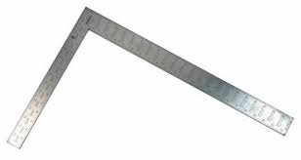
51. Carpenters Square

Slide 53
52. Pilot Hole/Counter Sink Bit

Slide 54
53. Scratch Awl

Slide 55
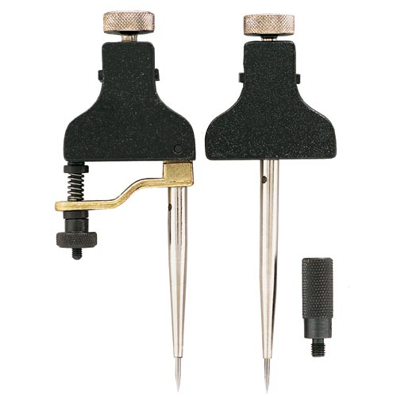
54. Trammel Points

