Slide 1
Joints, Hinges, and Bits

Slide 2
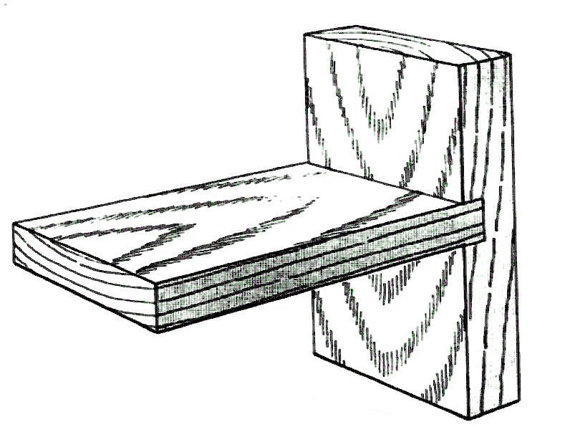
1._DADO____

Slide 3
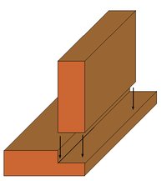
2.___Rabbet______

Slide 4
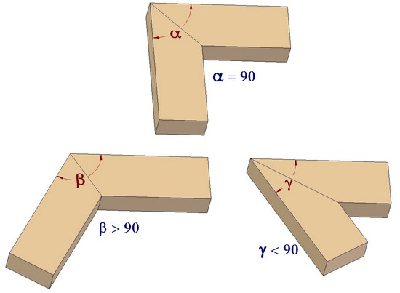
3.__Miter_____

Slide 5
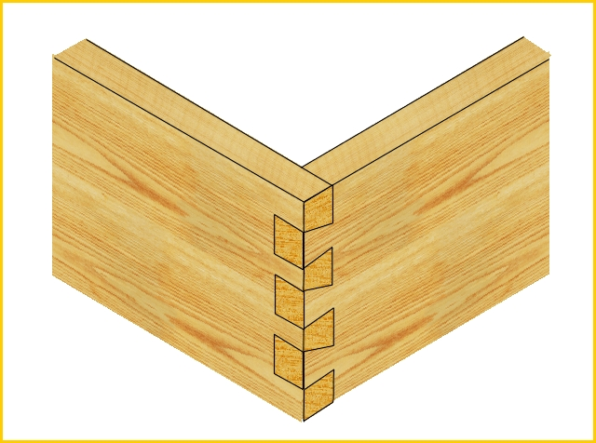
4. Dove Tail___

Slide 6
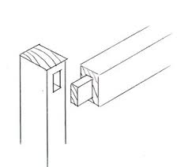
5._Mortise & Tennon_

Slide 7
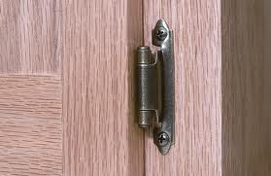
6._Overlay Hinge__

Slide 8
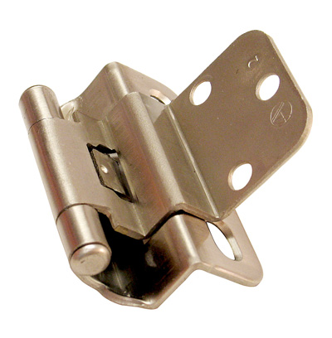
7._Inset Hinge_

Slide 9
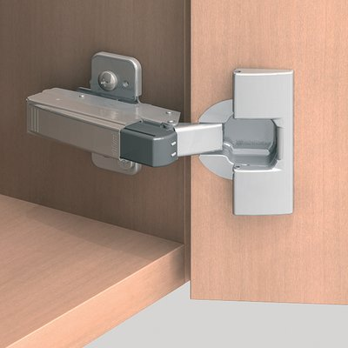
8._Concealed\European Hinge__

Slide 10
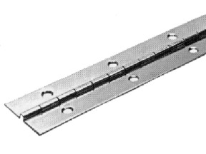
9._Continuous/Piano Hinge_

Slide 11
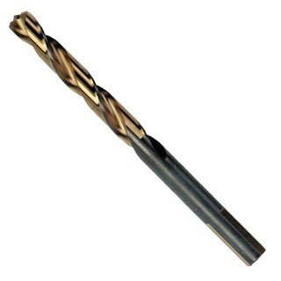
10._Twist Bit_

Slide 12
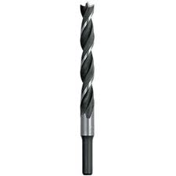
11.__Brad Point Bit__

Slide 13
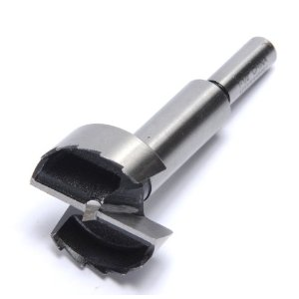
12.__Forstner Bit__

Slide 14
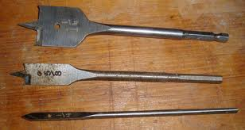
13._Spade Bit__

Slide 15
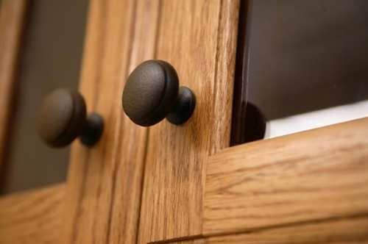
14._Knob____

Slide 16
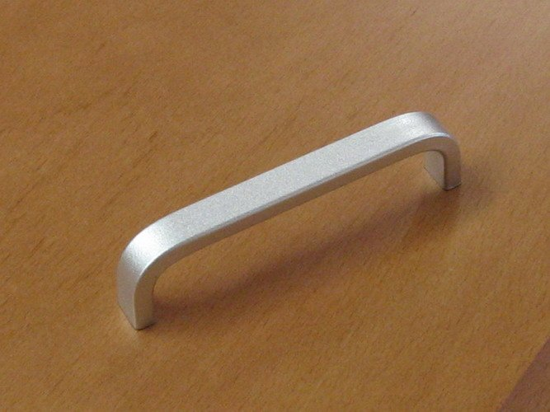
15.__Pull__

Slide 17
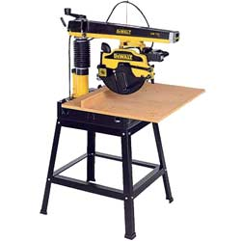
16._Radial Arm Saw__

Slide 18
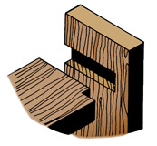
17. Blind Dado

